Slide 1
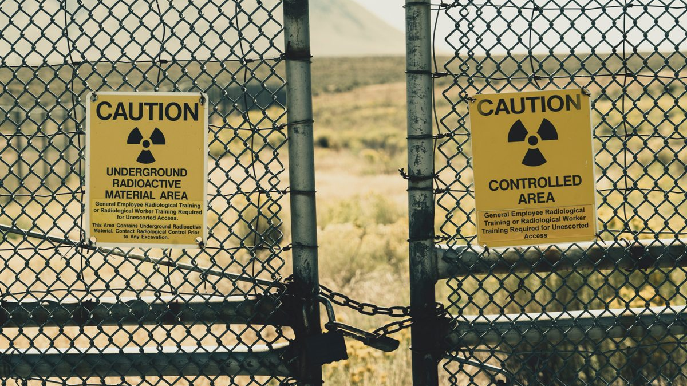
Notes:
LEONIE
Hello everyone, today we witnessed an accident: a damaged car lies on the middle of the road in a dangerous area. No mistakes are possible, and it is not possible to send any human operator. There are too many debris on the road, and we heard that a landslide could occur.
The only solution we have is to send a car from Tow Mater! No need to jeopardize any human life, every towing is autonomous and safe. Fortunately, we know that the GPS system of the damaged cars and their towing devices are not harmed.

Slide 2
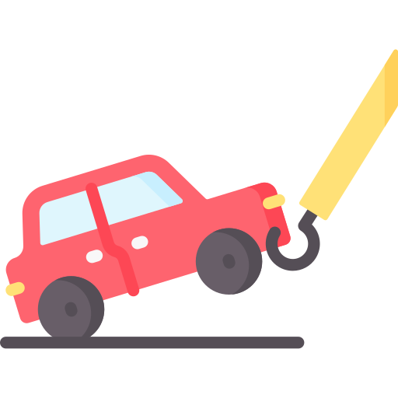

Tow Mater
Fourth review
+ Martin Chéliz
+ Laura Mendes
+ Samantha Gorrin
+ Alexis Pierre Dit Lambert
+ Imane El Khamlichi
+ Léonie Hatte
Notes:
LEONIE

Slide 3





Table of content
The final product
Release vision
Fourth release
Demonstration
Tests
Sprint evaluation
Time Schedule
FMECA
Trajectory Fault Tree
Obstacle Fault Tree
Camera Fault Tree
Next Sprint
Demonstration
Tests
Notes:
LEONIE

Slide 4
Part 1 : The product
Notes:
LEONIE/IMANE

Slide 5
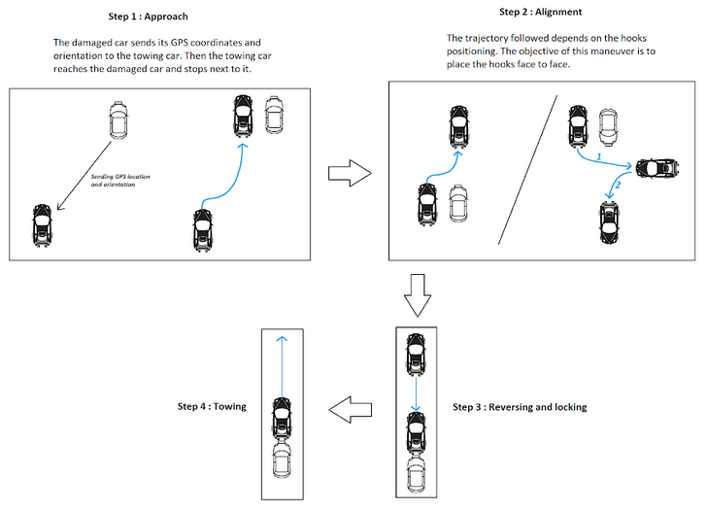
The final product
1
Sending GPS coordinates and reaching the damaged car
2
Maneuvering to place the hooks face to face
3
Reversing and locking
4
Towing
Performing the alignment maneuver and towing the car
Detecting and avoiding obstacles
Communicating with damaged car
Reaching the damaged car
Notes:
IMANE

Slide 6
Release vision
Sprint 4
Sprint 2
U-turn
Identifies moving obstacles
Stops when moving obstacles
Avoids fixed obstacles during alignment maneuver
The vehicles communicate
Reaches the damaged car
Performs the alignment
Follows a straight line
Locks the hook
Detects large obstacles
Speed regulation
No U-turn
Detects small obstacles
Identifies the car
Tows in a straight line
Sprint 1
Sprint 3
Sprint 5
Notes:
MARTIN

Slide 7
Fourth release
13/12
20/12
27/12
03/01
10/01
Time
Higher Priority
Lower Priority
Detecting and avoiding obstacles
Implement the avoidance trajectory
8
Detecting small or big moving obstacles
3
Samantha
Alexis
Léonie
Samantha
Imane
Get obstacle width and position with the Lidar
Martin
13
Communicating with the damaged car
Get the GPS coordinates of the damaged car
3
Laura
Configurate the communication between the two cars (send ACK)
3
Send GPS coordinates to the towing vehicle
3
Alexis
Notes:
MARTIN

Slide 8
Part 2 : The demo
Notes:
MARTIN/LAURA

Slide 9



Demonstration
Sending GPS coordinates
Sending acknowledgement
Getting an obstacle position
Avoiding fixed obstacle
Notes:
LAURA
9

Slide 10
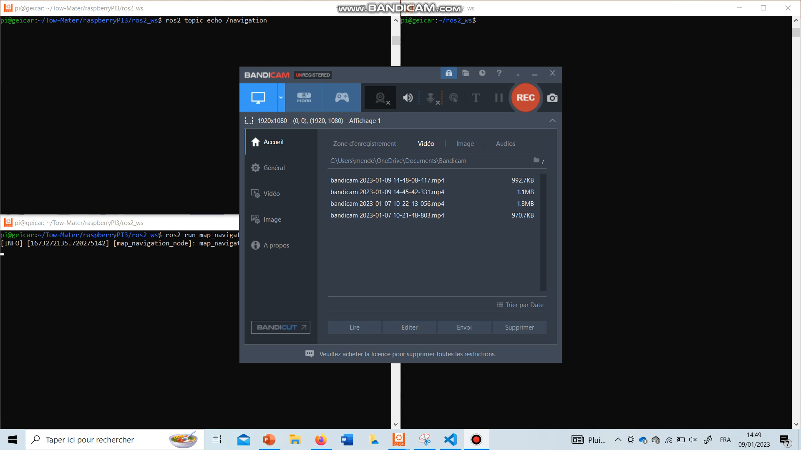
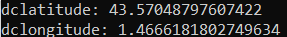
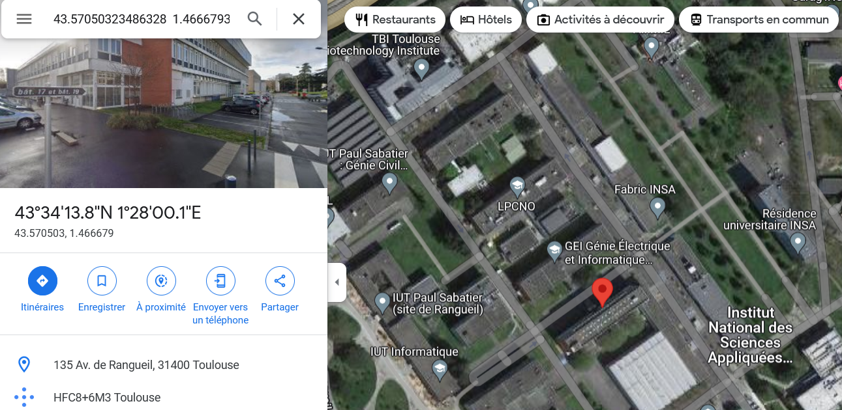
Tests (1/2)
Sending GPS coordinates
Sending acknowledgement
Maximum 10m one from another
GPS coordinates +/- 0,0001 °
(≈ 50cm)
Maximum 10 s after receiving the coordinates
Notes:
LAURA

Slide 11
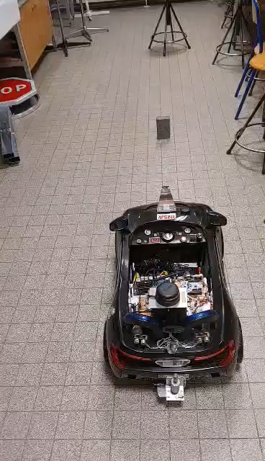
Tests (2/2)
Avoiding fixed obstacle
Minimum distance of 15cm
Maximum 20 cm drift from trajectory
IDLE
MANUAL MODE
Identification of a fixed obstacle after 5s
EMERGENCY
HOOK
MOVE
AVOIDANCE
Notes:
ALEXIS + Laura au clic du diapo

Slide 12
Part 3 : The analysis
Notes:
ALEXIS / LEONIE

Slide 13


Sprint evaluation
Sending GPS coordinates
Sending acknowledgement
Getting an obstacle position with LIDAR
Avoiding fixed obstacle
Maximum 10m one from another
Maximum 10 s after receiving the coordinates
Obstacle width
+/- 5 cm
Minimum distance of 15cm
GPS coordinates +/- 0,0001 °
(≈ 50cm)
Obstacle position +/- 5cm
Maximum 20 cm drift from trajectory
Identification of a fixed obstacle after 5s
Get the cars direction with the IMU
Notes:
LEONIE
13

Slide 14
Time Schedule
13/12
20/12
27/12
03/01
10/01
Time
Higher Priority
Lower Priority
Detecting and avoiding obstacles
Implement the avoiding trajectory
8
Detecting small or big moving obstacles
3
Samantha
Alexis
Léonie
Samantha
Imane
Get obstacle width and position with the Lidar
Martin
13
Communicating with the damaged car
Get the GPS coordinates of the damaged car
3
Laura
Configurate the communication between the two cars (send ACK)
3
Send GPS coordinates to the towing vehicle
3
Alexis
Notes:
LAURA

Slide 15
Time Schedule
13/12
20/12
27/12
03/01
10/01
Time
Higher Priority
Lower Priority
Detecting and avoiding obstacles
Implement the avoiding trajectory
8
Detecting small or big moving obstacles
3
Get obstacle width and position with the Lidar
13
Communicating with the damaged car
Get the GPS coordinates of the damaged car
Laura
Configurate the communication between the two cars (send ACK)
3
Get the GPS coordinates of the damaged car
1
3
Send GPS coordinates to the towing vehicle
3
Alexis
Send GPS coordinates to the towing vehicle
1
ROS2 advantages
Notes:
LAURA

Slide 16
Time Schedule
13/12
20/12
27/12
03/01
10/01
Time
Higher Priority
Lower Priority
Detecting and avoiding obstacles
Implement the avoiding trajectory
8
Detecting small or big moving obstacles
3
Samantha
Alexis
Léonie
Get obstacle width and position with the Lidar
13
Communicating with the damaged car
Get the GPS coordinates of the damaged car
3
Configurate the communication between the two cars (send ACK)
3
Send GPS coordinates to the towing vehicle
3
Notes:
LAURA

Slide 17
Time Schedule
13/12
20/12
27/12
03/01
10/01
Time
Higher Priority
Lower Priority
Detecting and avoiding obstacles
Implement the avoiding trajectory
8
Detecting small or big moving obstacles
3
5
Samantha
Get obstacle width and position with the Lidar
13
Communicating with the damaged car
Get the GPS coordinates of the damaged car
3
Configurate the communication between the two cars (send ACK)
3
Send GPS coordinates to the towing vehicle
3
Timer implementation
Notes:
LAURA

Slide 18
Time Schedule
13/12
20/12
27/12
03/01
10/01
Time
Higher Priority
Lower Priority
Detecting and avoiding obstacles
Implement the avoiding trajectory
8
Detecting small or big moving obstacles
3
Imane
Martin
8
8
Get the cars direction with the IMU
Get obstacle width and position with the Lidar
Get obstacle width and position with the Lidar
13
Communicating with the damaged car
Get the GPS coordinates of the damaged car
3
Configurate the communication between the two cars (send ACK)
3
Send GPS coordinates to the towing vehicle
3
LiDAR problems
Notes:
LAURA

Slide 19
Velocity chart
Notes:
LAURA
Ajouter « bonus »
Adapter au dernier sprint ( on a fait moins que prévu)
19

Slide 20
Part 4 : The risks
Notes:
LAURA / MARTIN

Slide 21
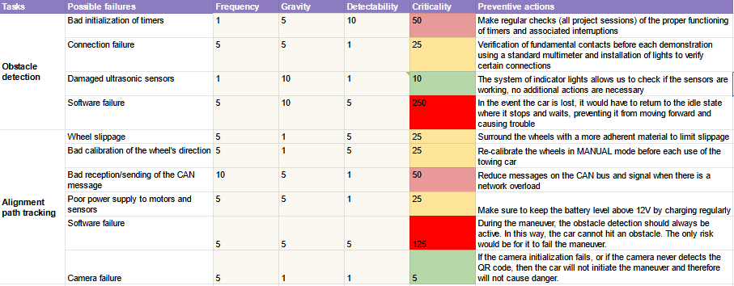
FMECA
Notes:
MARTIN
21

Slide 22
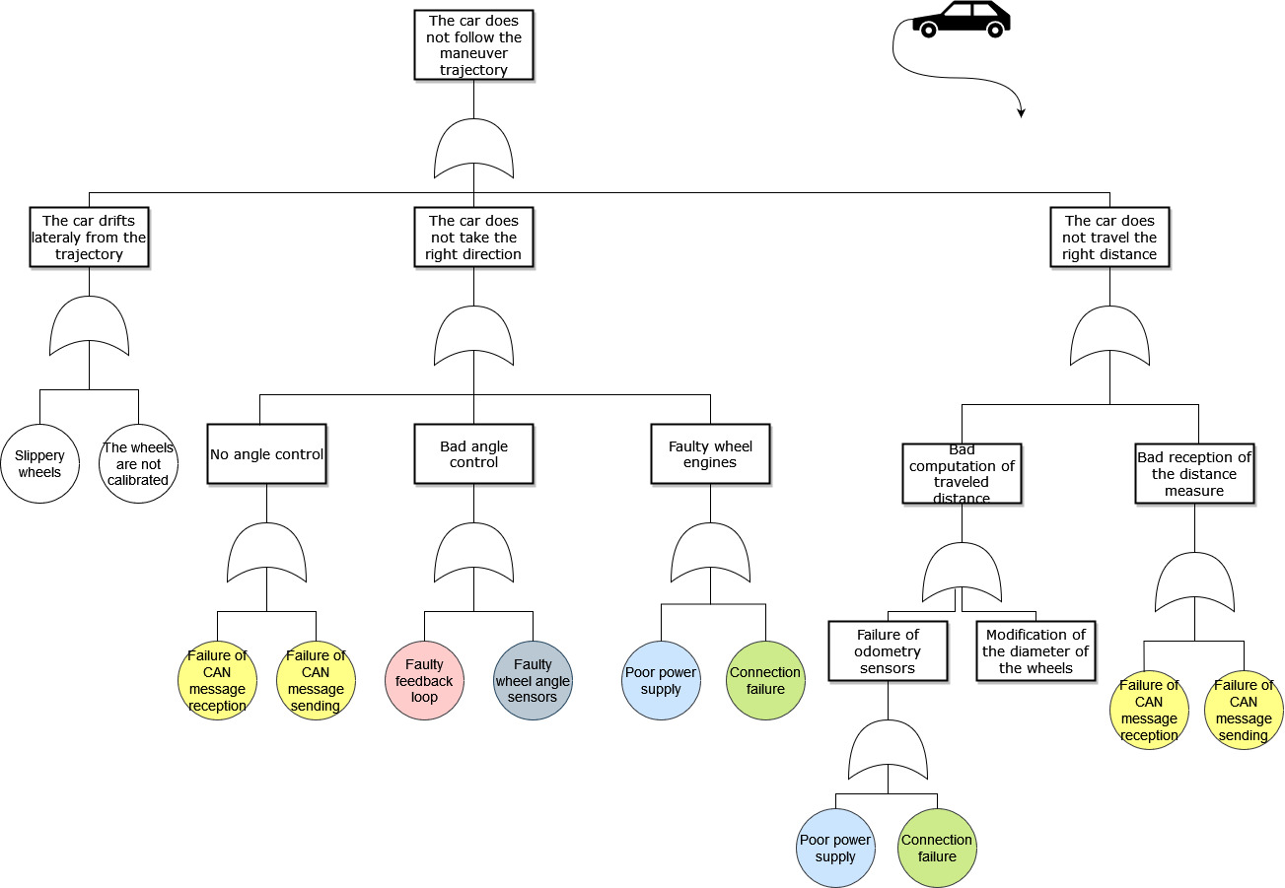
Trajectory
fault tree
Notes:
ALEXIS
22

Slide 23
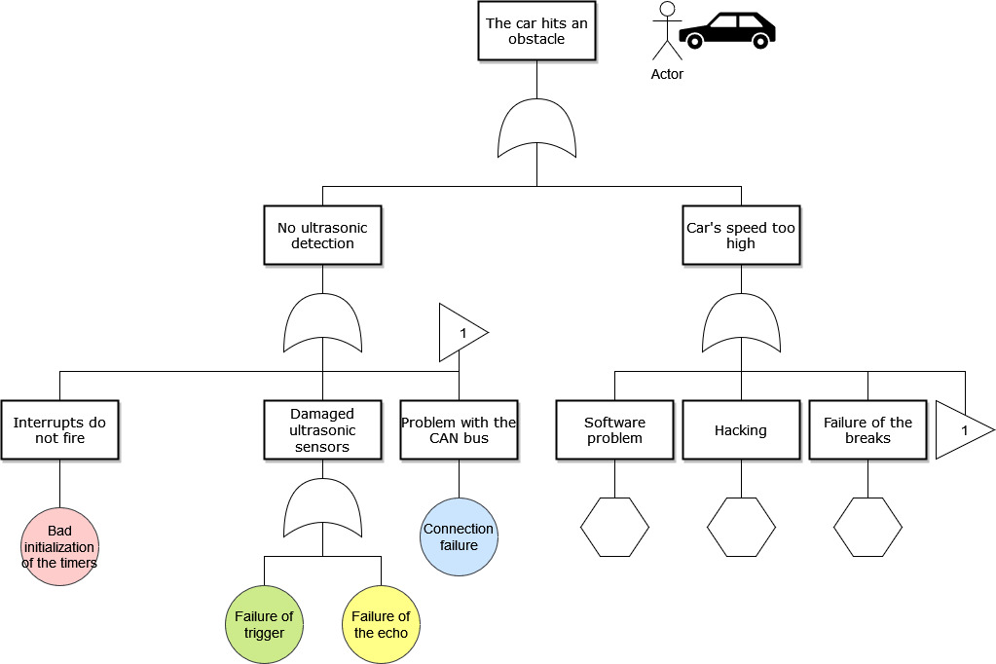
Obstacle
fault tree
Notes:
ALEXIS
23

Slide 24
Part 5 : The plan
Notes:
ALEXIS/IMANE

Slide 25
Next sprint
10/01
17/01
24/01
Time
Higher Priority
Lower Priority
Reaching the damaged car
Identify the position/orientation relative to the damaged car with the IMU
3
Martin
Imane
Fix the CAN to reduce risks
8
Alexis
Laura
Adapt the maneuver to the orientation
1
Document the project
Complete the Web Page
3
3
Finalize the project Plan
Avoiding the obstacles
Improve the avoiding trajectory and coming back to the initial position
Samantha
5
Léonie
Notes:
IMANE
Pistes :
Voir AMDEC : mettre en idle la voiture si perte de conexión
On est d’Accord, on ne fait pas l’approche ?

Slide 26
Demonstration
Sending GPS coordinates and acknowledgement
Setting manoeuvre of alignment
Detecting small obstacles
Lining up with the damaged vehicle
Avoiding fixed obstacle
Towing the car on a straight line
Notes:
SAMANTHA
26

Slide 27
Demonstration
Without U-turn
Sending GPS coordinates and acknowledgement
Setting manoeuvre of alignment
Detecting small obstacles
Lining up with the damaged vehicle
Avoiding fixed obstacle
Towing the car on a straight line
Notes:
SAMANTHA
27

Slide 28

Demonstration
With U-turn
Sending GPS coordinates and acknowledgement
Setting manoeuvre of alignment
Detecting small obstacles
Lining up with the damaged vehicle
Avoiding fixed obstacle
Towing the car on a straight line
Notes:
SAMANTHA
28

Slide 29
Tests
Sending GPS coordinates and acknowledgement
Determine the maneuver of alignment to do
Manoeuvring to line up with the damaged vehicle
Detecting a small obstacle
Towing the car on a straight line
Avoiding fixed obstacle
Maximum 10m of gap
Orientation +/- 20°
Alignment of maximum 5 cm interval
Obstacle smaller than
30 cm
Autonomous towing
Minimum distance of 15cm
GPS coordinates +/- 0,0001 °
(≈ 50cm)
Choice of the maneuver in less than 10s
Stops 75 cm +/- 5 cm away from obstacle
Tow the damaged car on a minimum 2m straight line
Maximum 20 cm drift from trajectory
Maximum 10 s after receiving the coordinates
Stops in less than 5s
Identification of a fixed obstacle after 5s
Notes:
SAMANTHA
29

Slide 30





New
To improve
Detecting and avoiding fixed obstacle
Use the cars orientations to choose the maneuver
Communicating the GPS coordinates of the damaged car
CAN
Determine the cars orientations with the IMU
Security
Notes:
SAMANTHA ?

Slide 31

Questions ?
Notes:
SAMANTHA ?

